Slide 1
Revision
Arrays, Pointers, Functions, Strings and Structures in C

Slide 2
Arrays
An array is a composite data structure and is made up of simple data types or structured data types
The simplest form of array is an one dimensional array defined as: a finite ordered set of homogeneous elements
Finite means – a specific number of elements in the array
Ordered means that the elements of array are arranged so that we can identify them as 0th, 1st, …
Homogeneous means – all elements are of same type
Usage: If we need to process salary of 20 employees, we will need 20 variables with different names to store their salary

Slide 3
Array declaration
int a[100] : creates consecutive spaces for 100 integers having names as a[0], a[1]….a[99]
Note: Any data structure is completely described only if in addition to its form, other basic operations like accessing the structure, extraction, storing, etc are also well defined
Any element of an array can be directly accessed as a[i]
So extraction is done by a[i] where a and i are given
Storing is done by assignment where a, i and an element x is given a[i] =x;

Slide 4
Implementing one dimensional array
int b[100];
Reserves 100 successive integer memory locations
Address of first element called the base address is denoted by base(b) or b
First element is accessed as b[0] or *b
The address of b[2] is base(b) + 2*esize, esize: size of one element
b[2] is same as *(b+2)
In C language, array variable is implemented as pointer variable

Slide 5
Pointer Variable
Pointer variable stores a memory address
Allows C programs to implement call-by-reference
Allows a programmer to create and manipulate dynamic data structures
Must be defined before it can be used
Should be initialized to NULL or valid address
NULL pointer: a special type of pointer which has special pointer value i.e. NULL and it does not point to any value.
Declaration of pointers:
<type> *variable; int *p; float *x;
<type> *variable = initial-value; int *p = NULL; float *x = NULL;

Slide 6
Cont..
A pointer variable has a Direct value: The address of a memory cell
An Indirect value: The value of the memory cell whose address is the pointer's direct value and it is referenced by using the indirection operator *

Slide 7
Storing value in a pointer variable
One way to store a value in a pointer variable is to use the & operator
int a = 10;
int * p = &a;
(We say that p points to a)
If we do *p = 100; it changes the value of a to 100.
Note: * is used in two ways..
* in a declaration states that the variable is a pointer type instead of a regular variable of that type
* in an expression indicates the value in the location pointed to by the address stored in the variable

Slide 8
Pointers and Dynamic memory allocation
int *p;
p = (int*) malloc(sizeof(int));
It returns pointer to allocated space for an object of size mentioned)
This memory is created at run time
This variable is created at Heap memory
We have two types of memory associated with a program : Stack and Heap

Slide 9
Arrays and Pointers
Single dimensional array – Dynamic allocation
int *a;
a = (int* )(malloc(10*sizeof(int)))
for(i=0;i<10;i++)
a[i] = 20 +i*2;

Slide 10
Some pointers related exercise problems
Prob1. Write a program which reads a number n, then reads the marks of n students and then calculates the average marks and maximum marks and minimum marks.
Prob2. int * x; int a[5];
x = (int *)malloc(5*sizeof(int))
For(i=0;i<5;i++) {a[i] = 10; x[i] = 20; *(a+i) = x[i]; *(x+i) = *a +300;}

Slide 11
Debugging a program..
#include <stdio.h>
void main()
{ int arr[5];
int n, *p;
n =20;
p = &n;
*p = *p +n;
printf(" Value stored at address p = %d and n = %d\n”, *p,n);

Slide 12
Cont..
for(i=0;i<5;i++)
{printf("element - %d : ",i);
scanf("%d",&arr[i]);
}
p = arr;
for(i=0; i<5; i++)
{ arr[i] = arr[i]-i;
*(p+i) = arr[i] + 2*i;
}
for(i=0;i<5;i++)
printf(" The values of array are %d\n”,arr[i]);
}

Slide 13
Functions
C allows us to break our program into segments called functions
Every function shall do a well defined task
A function is a block of statements that performs a specific task.
A function can be thought of as a black box that takes its input through arguments and returns a single value result using return statement
Function declaration is done as : return_type function_name(type arg1, type arg2..)
Function definition: When the function is defined, space is allocated for that function in the memory and it has two parts: Function header and function body
Function call: Function call invokes the function (name of the function and the value of arguments)

Slide 14
Cont..
Functions are used because of following reasons – a) To improve the readability of code. b) Improve the reusability of the code, same function can be used in any program rather than writing the same code from scratch. c) Debugging of the code would be easier if we use functions, as errors are easy to be traced. d) Reduce the size of the code, duplicate set of statements are replaced by function calls.

Slide 15
Types of functions
Predefined standard library functions
Standard library functions are known as built-in functions.
Functions such as puts(), gets(), printf(), scanf() etc are standard library functions.
These functions are already defined in header files (files with .h extensions are called header files such as stdio.h)
User Defined functions
The functions that we create in a program are known as user defined functions.
or
a function created by user is known as user defined function.

Slide 16
Parts of function
return_type: Return type can be of any data type such as int, double, char, void, short etc.
function_name: It can be anything, however it is advised to have a meaningful name for the functions so that it would be easy to understand the purpose of function just by seeing just the name.
argument list: Argument list contains variables names along with their data types. These arguments are kind of inputs for the function. For example – A function which is used to add two integer variables, will be having two integer arguments.
Function body: Set of C statements, which will be executed whenever a call will be made to the function.

Slide 17
Example program
#include <stdio.h>
int addition(int num1, int num2)
{ int sum;
sum = num1+num2;
return sum;
}
int main()
{ int var1, var2;
printf("Enter number 1: ");
scanf("%d",&var1);
printf("Enter number 2: ");
scanf("%d",&var2);
int res = addition(var1, var2);
printf ("Output: %d", res);
return 0;
}

Slide 18
Few Points regarding functions in C
main() in C program is also a function.
Each C program must have at least one function, which is main().
There is no limit on number of functions; a C program can have any number of functions.
A function can call itself and it is known as “Recursion
Data type of returned value can be void also, in such case function doesn’t return any value.
If a function return type is char, then function should return a value of char type and while calling this function the main() function should have a variable of char data type to store the returned value

Slide 19
Passing parameters to Functions
Call by value: The values of the variables are passed by calling the function to the called function
Call by reference: The addresses of the variables are passed by the calling function to the called function
Write a program which calculates the average SPI of all students using functions.
Write a program to swap two numbers and two strings through functions

Slide 20
Pass by reference
include <stdio.h>
int addition(int *num1, int *num2)
{ int sum;
sum = *num1+*num2;
return sum;
}
int main()
{ int var1, var2;
printf("Enter number 1: ");
scanf("%d",&var1);
printf("Enter number 2: ");
scanf("%d",&var2);
int res = addition(&var1, &var2);
printf ("Output: %d", res);
return 0;
}

Slide 21
Function calling : different cases
The functions available in a code may accept an argument or may not accept it at all. Thus, it may return any of the values or may not do so. On the basis of these facts, the function calls have the following four aspects:
A function that has no arguments and has no return value.
A function that has no arguments but has a return value.
A function that has arguments but has no return value.
A function that has arguments and also has a return value.

Slide 22
Formal parameters…
When a function needs to use the arguments, it has to declare those variables that happen to accept the arguments’ values. Such variables are known as the function’s formal parameters.
The formal parameters behave just like any other local variables inside our given function. These parameters get created when they enter into a function. When the function exits, those get destroyed.
During the calling of a function, there will be two ways in which we can perform the passing of these arguments to a given function:

Slide 23
Cot..
The Call by Value: This method creates a copy of the actual value of the given argument in the parameter of the function that is formal in nature. Here, the changes that appear on the parameter (that exists inside the function) create no effect whatsoever on the available argument.
The Call by Reference: This method creates a copy of the address of the given argument into the parameter that is formal in nature. Inside this function, the use of address helps in accessing the actual argument that comes in use in this call. It means that the changes that appear on the parameter are bound to affect the given argument.

Slide 24
Examples…
To be discussed on class room board

Slide 25
More topics related to pointers and arrays
Operations on arrays
Two dim arrays
Generic pointer
Pointer to pointer
Array of pointers
Operations:
Traversing an array: accessing elements of array (lower bound, upper bound)
Searching an element in an array: simple
Inserting an element in an array
Deleting an element from an array
Merging two arrays

Slide 26
Inserting an element in the array
Cases:
Insert at the end of the array: Simple
Insert at some other place in between lower bound and upper bound
Algorithm to insert an element in the middle of array:
Suppose we have to insert the element at position pos
Move all elements from pos to upper_bound to pos+1 to upper_bound +1
Insert the element at pos
Set upper bound to upper bound +1

Slide 27
Deleting an element from array
Delete from the end of the array: Simple
Delete from some other place in between lower bound and upper bound
Algorithm to delete an element in the middle of array:
Suppose we have to delete at position pos
Move all elements from pos+1 to upper_bound to pos to upper_bound -1
Set upper bound to upper bound -1

Slide 28
Assignment
Write a program that does the following:
Declare an array of integers of size 20
Insert 10 integers (10, 15, 20, 40, 45, 50, 60, 100, 150, 200) in the array
Print the lower bound and upper bound of array, and how many numbers are stored in the array
Print all the integers which are multiple of 10
Insert three more integers (250, 5, 65) in the existing array
Print the new array
Delete three numbers ( 34, 15, 60) from the existing array
Print new array
Write a program to read 4 digits and form a number using these digits.

Slide 29
Merging two arrays
Merging two arrays means first copying the contents of first array into the third array and then copying the contents of second array into the third array.
If the two arrays are unsorted them merging is simple but if the arrays are sorted and merged array is also required to be sorted then it is not so straight forward.

Slide 30
Few Practice problems
Suppose an array is declared as: arr[] = {1,3,5,7,9};
What is the value of:
sizeof(arr[3])
arr[3]
2. For double arr[50]
how many bytes will be allocated
How many elements it can hold
What will be the address of 5th element if the address of first element is 1000

Slide 31
3. How can we access the ith element of an array a
*(a+i) *(i+a) a[i] all of these
True or false
An array name can not be used as a pointer
Entire array can be passed as a function argument
Is there a single function which can operate on all the elements of an array
The index of an array specifies the offset from the beginning of the array to the element being referenced

Slide 32
Two Dimensional arrays

Slide 33
Two Dimensional arrays
int a[3][5] defines a two dimensional array having 3 rows and 5 cols
It is implemented as a one dimensional array of size 3 where each element is again a one dimensional array of size 5
We can also call it a matrix
An element is referenced as a[i][j]
The logical view and physical view of a two dim array are different
Logical view is a table but the hardware of computers does not have such facility and memory is allocated linearly.
Hence elements are linearly ordered allowing the simple address calculation

Slide 34
Cont..
Mostly it is row major representation.
This means elements are ordered as:
a[0][0]…..a[0][4]; a[1][0]….a[1][4]; a[2][0]….a[2][4]; a[3][0]…a[3][4]
So the address of a[i][j] will be calculated as:
a+ ((i)*n + (j)) *sizeof (datatype)
Exercises??

Slide 35
Multi-Dimensional arrays
A three dimensional array can be declared as:
A[3][4][5]
It has 3 planes, 4 rows and 5 cols.
Elements will be stored sequentially as: a[0][0][0], a[0][0][1]…a[0][0][4]; a[0][1][0]……a[0][1][4]; a[0][2][0]……a[0][2][4]; a[0][3][0]……a[0][3][4];
a[1][0][1]…a[1][0][4]; a[1][1][0]……a[1][1][4]; a[1][2][0]……a[1][2][4]; a[1][3][0]……a[1][3][4];
a[2][0][1]…a[2][0][4]; a[2][1][0]……a[2][1][4]; a[2][2][0]……a[2][2][4]; a[2][3][0]……a[2][3][4];

Slide 36
Assignments
Page 38 (Tanenbaum)
Exercises: 1.2.1; 1.2.3; 1.2.5; 1.2.6; 1.2.9; 1.2.10

Slide 37
Dynamic memory allocation
Two dimensional array – Dynamic allocation
int **a;
a = (int** )(malloc(10*sizeof(int*)))
for(i=0;i<10;i++)
*(a+i) = (int *)malloc(5*sizeof(int)))
for(i=0;i<10;i++)
for(j=0;j<5;j++)
a[i][j] = i+j;

Slide 38
Arrays as Parameters..
When we pass an array in a function, we do not have to pass its range.
The range of array is specified in main program
Arrays are implemented as pointers so the address of the original array is passed instead of making the copy.
The parameter refers to the original array that was allocated in the calling program.

Slide 39
Generic pointer
A generic pointer is a pointer that has its type void. It is a special type of pointer that can point to the variables of any data type.
void * ptr;
We need to cast a void pointer to another kind of pointer before using it
void *p; int I;
p = &I;
print(*(int *)p)

Slide 40
Simple practice problems
Pointers

Slide 41
_ pointer does not point to any valid memory address.
Ans: NULL
Size of character variable pointer is same as size of integer variable pointer
True

Slide 42
Output Problems
main()
{int arr[] = {1,2,3,4,5};
int *ptr, i;
ptr = arr +4;
for(i=4;i>=0;i--)
printf(“\n %d”, *(ptr-i));
for(i=0;i<5;i++)
printf(“\n %d”, *(ptr-i));
printf(“%d \n”, *++arr);
}

Slide 43
int a = 3;
int *b = &a;
printf(“%d %d \n”, ++a,*b);
printf(“%d %d \n”, a,*b++);
printf(“%d %d \n”, a,++*b);

Slide 44
Q1. Write a program to read and display values of an array having float values. Allocate space dynamically.
Steps:
Declare a pointer(float)
Read the size of array in num
Allocate memory
Read num numbers
Print num numbers

Slide 45
Structures
A structure is a collection of variables under single name
Structure is similar to a record and stores related information about an entity
A structure is a group of items in which each item is identified by its own identifier
Every field of structure is called member
A structure is declared using the keyword “struct” followed by structure name
All the variables of structure are declared within structure as:

Slide 46
Cont..
struct student { int rollno; char name[30]; char branch[10];};
struct student avinash, saurabh, neha;
Now avinash is a structure which has three fields rollno, name, branch
How do we access these fields……
avinash.rollno = 405;
strcpy(avinash.name,”Avinash”);
strcpy(avinash.branch,”cse”);

Slide 47
Cont…
typedef of C can be used to redefine/rename the structure
typedef struct student
{ int rollno;
char name[30];
char branch[10];} jklu_student;
jklu_student avinash, saurabh, neha;
Each member of structure is accessed as : avinash.rollno, avinash.name, neha.branch,…etc

Slide 48
Example program of structures
struct employee { int idno; char name[20];};
struct employee manish, e[10];
printf(“\n enter idno of manish”);
scanf(“%d”, &manish.idno);
printf(“\n enter name of manish”);
scanf(“%s”, manish.name);
for(i=0;i<10;i++)
{printf(“\n enter idno of e %d”,i);
scanf(“%d”, &e[i].idno);
printf(“\n enter name of e %d”, i);
scanf(“%s”, e[i].name);
}}

Slide 49
Memory allocation for structures
Structure is a user-defined data type that enables us to store the collection of different data types.
Each element of a structure is called a member.
Structure is similar to class in the sense that it is a blueprint to store various types of information under one name representing an object without its functionality.
What happens when we define a structure: Just a new user defined data type is defined, no memory allocation is done.

Slide 50
Cont..
When we declare variables of “struct” type then only memory is allocated like it is done for atomic variables.
struct student{ int rollno; char name[20]; int age;};
// no memory allocation
struct student s1, s2;
// Two structures created each, with 28 bytes

Slide 51
Self Referential structures
Self Referential structures are those structures that have one or more pointers which point to the same type of structure, as their member.
Linked lists use self referential structures

Slide 52
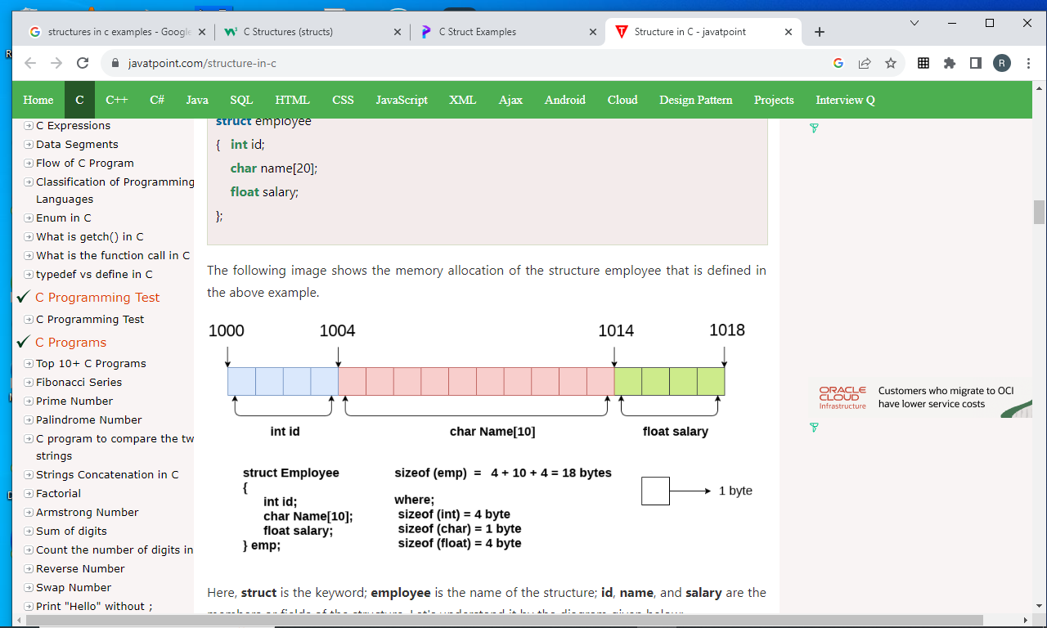
Cont..

Slide 53
Nested structures
A structure can contain another structure
struct student_name {char firstname[20]; char lastname[20];};
struct student{ struct student_name name;
int rollno;
};
struct student s1;
Elements will be accessed as:
s1.name.firstname, s1.name.lastname, s1.rollno;

Slide 54
Different ways of declaring structures…
struct employee
{ int id;
char name[50];
float salary;
};
struct employee e1, e2;
struct employee
{ int id;
char name[50];
float salary;
} e1, e2;

Slide 55
Accessing members of the structure..
There are two ways to access structure members:
1. By . (member or dot operator)
2. By -> (structure pointer operator)
Struct student * s1;
S1 = (struct student*) malloc(sizeof(struct student))
S1->rollno = 101;

Slide 56
Use of Arrow operator
struct employee { int idno; char name[20];};
int main()
{
struct employee *manish;
manish = (struct employee *) malloc(sizeof (struct employee))
printf(“\n enter idno of manish”);
scanf(“%d”, (*manish).idno);
printf(“\n enter name of manish”);
scanf(“%s”, (*manish).name);
printf(“Id no = %d Name = %s\n”, manish->idno,manish->name);
}}

Slide 57
Initializing Structures
struct date{ int day; int month; int year;}
struct date today = {31,12,2022};
A structure may be initialized at the time it is declared
The Order is essential
The sequence of values is used to initialize the successive variables in the structure
It is an error to have more initializers than members
If fewer initializers than the members, the initializers provided are used to initialize the data members and the remaining are initialized to 0 if primitive type

Slide 58
Passing structures to functions
Passing individual members
struct point {int x; int y;}
void fun(int,int);
main() {struct point p1 = {2,3};
fun(p1.x,p1.y);
}
void fun(int a, int b)
{printf(“value =%d \n”,a*b);}

Slide 59
Passing structures …….
Passing entire structure
struct point {int x; int y;}
void fun(struct point);
main() {struct point p1 = {2,3};
fun(p1);
}
void fun(struct point b)
{printf{“value = %d\n”,b.x* b.y);}

Slide 60
Passing the address of structure…
Passing the address of the structure
struct point {int x; int y;}
void fun(struct point*);
main() {struct point p1 = {2,3};
fun(&p1);
}
void fun(struct point* b)
{printf(“%d %d %d %d \n”, b->x, b->y, (*b).x *(*b).y), b->x*b->y;}

Slide 61
Array of structures
struct student s[10];
Note: s is structure variable and student is structure name
So now there are 10 students s[0], s[1]…..s[9] where each student is defined by three fields.

Slide 62
Exercise
Define a structure called a room.
Create two rooms of different sizes. Create a room dynamically.
Write three functions: area, volume, bigger
In first function pass the individual members of structure
In the second function pass the whole structure
In third function pass the address of structure

Slide 63
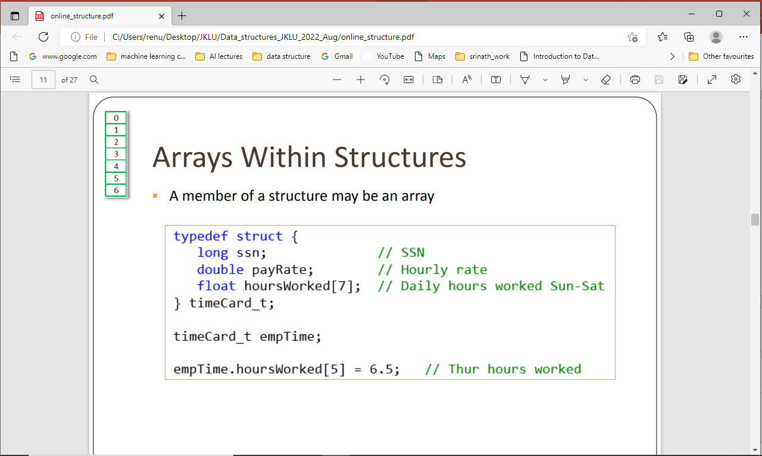
Arrays Within Structures

Slide 64
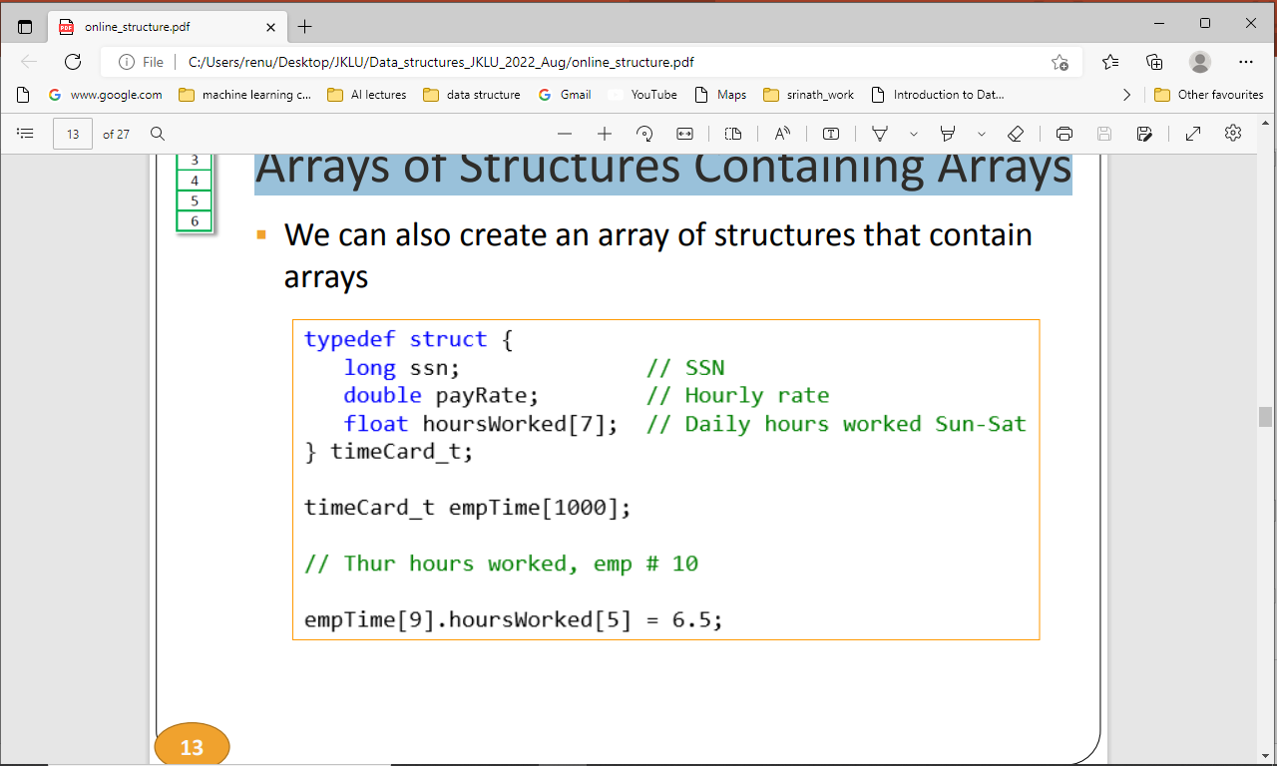
Arrays of Structures Containing Arrays

Slide 65
Return Structure pointer to Local Variable
struct point {int x; int y;}
struct point * area(struct point*);
main() {struct point p1 = {2,3}, *p2;
p2 =area(&p1);
}
struct point * area(struct point* b)
{printf(“%d %d %d %d \n”, b->x, b->y, (*b).x *(*b).y), b->x*b->y;);
b->x =b->x +10;
return b; }
Note: This can be quite dangerous in big programs : why??

Slide 66
Allocation of Storage and scope of Variables
Storage allocation: At what point a variable gets associated with actual storage
Scope of a variable: At what point in a program a particular variable can be referenced
All variables and parameters declared within a function are called automatic or local and they can be referenced only within the function
Automatic variables may be declared within any block {} and they are visible only in that block
Second class is global and they are declared outside the function and their scope is from the declaration point to end of the program.

Slide 67
Cont..
Static variable: For this storage remain allocated throughout the execution of the program and memory is allocated only once. This way it retains the previous value of the variable even after recalling the function
Scope of the static variable is like auto variable if it is within the function and global if it is outside the function.
But a global static variable can not be used in another file using extern.
Static variable is always initialized

Slide 68
Cont..
A special kind of variable is declared extern if we want to define a global variable in one source file and use that in another file
File1 : int marks;
File2: extern int marks;
File1 : int marks[10];
File2: extern int marks[];

Slide 69
Strings in C

Slide 70
Character Strings in C
String: An array of characters
String is an important data structure because computers are used for word processing applications such as creating, inserting, modifying textual data
Each string is terminated by a null character denoted by escape sequence ‘\0’ which indicates end of the string
char s[] = “hello”;
When the compiler encounters a sequence of characters enclosed in the double quotation marks, it appends a null character \0 at the end by default.
In above example, a character array of size 6 is created where the lower bound of array is 0 and upper bound is 5.
A null character is automatically appended to the end of the string
Char s[10] = “hello”; an array of size 10 is created where last five spaces are initialized by null character.

Slide 71
Another way of creating a string:
char s[] = {'H', 'e', 'l', 'l', 'o', '\0'};
The difference between the two ways of creating strings is:
The first method is easier to write and we do not have to include the \0 character explicitly.
In the second method we have to include null character at the end explicitly.
Examine these:
char greetings[] = {'H', 'e', 'l', 'l', 'o', ' ', 'W', 'o', 'r', 'l', 'd', '!', '\0'};
char greetings2[] = "Hello World!"; printf("%d\n", sizeof(greetings)); printf("%d\n", sizeof(greetings2));
The size of both arrays is same and both have 13 characters (adding space that also counts as a character and the \0 character)
Note: char s[5]= “hello”; in this case null character will not be appended automatically.
Hence, when we declare a string like char str[100] then we can store maximum 99 characters

Slide 72
Declaring, initializing and assigning a string
char c[20]; (declare)
Initializing a string:
char c[] = "abcd";
char c[50] = "abcd";
char c[] = {'a', 'b', 'c', 'd', '\0'};
char c[5] = {'a', 'b', 'c', 'd', '\0'};
Assigning a value to string:
char c[100];
c = "C programming"; {Error, once an array is declared, can not assign value to it like this, We have to assign values through for loop}
Note: At the time of Initialization we can do like this.

Slide 73
Reading the strings
char mystring[10]; It can be read as:
Using scanf() function: scanf(“%s”,mystring)(does not require & like int, float and char values)
scanf() terminates as soon as it gets a blank space
Using gets() function;
gets(mystring);
It overcomes the drawback of scanf. It takes the initial address of string and reads till the null character or end of line.
Using getchar(), getch() functions repeatedly
i = 0;ch = getchar(); while(ch!=‘*’) (mystring[i] = ch; ch = getchar();i++;} str[i] = ‘\0’;

Slide 74
Writing Strings
Strings can be displayed on the screen in three ways:
printf() 2. puts() 3. putchar()
char greetings[] = "Hello World!";
printf("%s", greetings); printf("%c", greetings[0]);
printf("%c", greetings[4]);
Note: We can also specify the width of output field
Using puts() function; It is a simple function. It terminates the line with a newline character ‘\n’;
Using putchar() function repeatedly
i = 0;while(ch[i] !=‘*’) (putchar(ch[i]); i++;};

Slide 75
Read and write strings
#include <stdio.h>
#include <string.h>
int main() {
char name[20];
printf("Enter the name:");
scanf("%s", name);
printf("%s",name);
return 0; }
Things to note: & sign is not used when reading strings; scanf reads the string till it gets a space character. Check the output for different types of names.

Slide 76
Using puts and gets functions..
#include <stdio.h>
#include <string.h>
int main()
{ char nickname[20];
puts("Enter your Nick name:");
gets(nickname);
puts(nickname);
return 0;
}
Note: %s is not required in puts and gets

Slide 77
Some common operations on strings (implement in the lab)
Finding the length of a string
Converting characters of string into upper case
Concatenating two strings to form a new string
Appending strings
Comparing strings
Reversing a string
Extracting a substring from the left of a string
Extracting a string from the right of a string
Extracting a substring from the middle of a string

Slide 78
Finding the length of a string
int main()
{ char str[20]; int i=0, length;
printf(“\n enter the string:”);
gets(str);
while (str[i]!=‘\0’) i++;
length = i;printf(“\n length = %d\n”, length)
return 0;
}

Slide 79
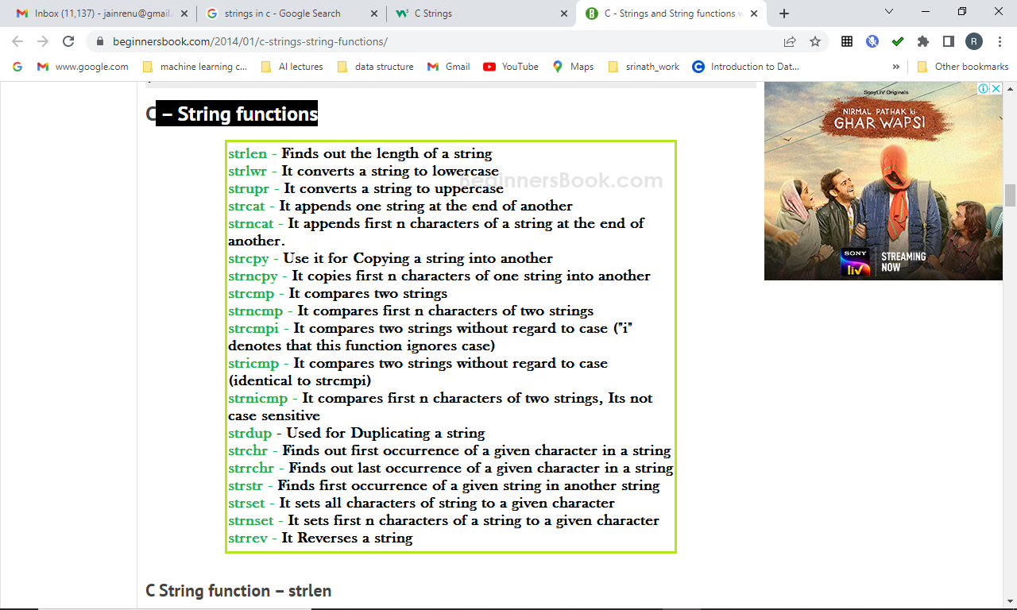
String functions

Slide 80
Array of strings
If we have to store names of 10 students then we have to declare an array of strings.
String is an array of characters.
Hence an array of array of characters (two dim array)
char name [10][20];
Equivalent to 10 variables of name: where each has maximum size 20
Or there are 10 strings of size 20
name[0], name[1], name[2]……………..name[9]

Slide 81
Cont..
char name [5][10] = {“ram”,”mohan”,”sita”, Shyam, “Rakesh”};

Slide 82
Sample program
#include <stdio.h>
void read_names(char s_name[5][10],int n)
{int i; for (i=0;i<n;i++)
{printf("enter %d student name\n",i);
gets(s_name[i]);
puts(s_name[i]); }
}
void main()
{ int n; char names[5][10]; n =5; read_names(names,n);
printf("second name = %s\n",names[1]); }

Slide 83
Pointers and Strings
String is an array of characters
So the concept of pointers is same as in the case of ordinary arrays

Slide 84
Class and lab exercise
Write a function that reverses the character string s.
char * reverse(char *s)
{int k,i;
Int l = len(s);
char rev[l];
for (i=0,k = s[l-1]; i<l;k==0; i++,k--) rev[i] = s[k];
rev[l] =‘\0’;

Slide 85
More on Strings in C..
There are two ways to store string:
char p[20] or a pointer pointing to a string char* s = “abacdef” and both can be accessed as arrays.
But, following are the key differences:
The operator sizeof(p) will give the memory allocated to character array.
sizeof(s) will give size of pointer which is independent of the string pointed by s.
Each string is appended by a null character (‘\0’) which indicates the end of the string.
The length of string can be calculated using strlen() function.
But, the function does not include null character ‘\0’ in the length. .
p is a character array, its individual elements can be modified (p[i] = ‘c’).
As s is a pointer, it can be pointed to any other string as well (s =”string2”). However, using p, it is not possible.

Slide 86
Que – 1. What does the following fragment of C-program print?
char c[] = "GEEK2018"; char *p =c; printf("%c,%c", *p,*(p+p[3]-p[1]));
(A) G, 1
(B) G, K
(C) GEEK2018
(D) None of the above

Slide 87
#include<stdio.h>
#include<string.h>
void main()
{char p[10] = "hello";
char * s = "string";
printf("length of p %lu length of s %lu\n",strlen(p),strlen(s));
p[3] ='L';
//s[3] = 'L';not allowed
printf(" p %c s %c\n",p[2],s[4]);
}

Slide 88
#include<stdio.h>
#include<string.h>
#include<stdlib.h>
void main()
{char p[10] = "hello";
char * s = "string";
char *news = "newstring";
news = (char*) malloc(10*sizeof(char));
news[6] = '5';
printf("length of p %lu length of s %lu\n",strlen(p),strlen(s));
p[3] ='L';
//s[3] = 'L';not allowed
printf(" p %c s %c %c \n",p[2],s[4], news[6]);

